Slide 1
Smart Contact Manager

Slide 2
Introduction
The Smart Contact Manager provides Microservice Architecture
based software solution.
It provides high Availability operations for their client & server without disruption.
Different Microservices combines together to perform together as a Uniﬁed application.

Slide 3
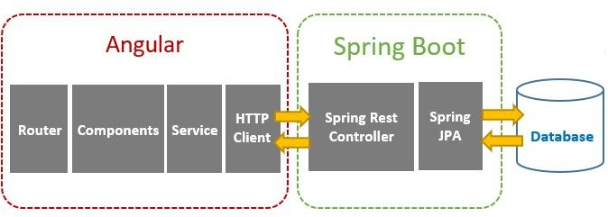
Client - Server Architecture

Slide 4
Technologies Used
Front End : Angular
Backend : Java, Spring Boot
Database : MySQL
Tools : Spring Tool Suite, Swagger, Postman

Slide 5
Working Microservices:
Authorization microservice
Contact microservice
User microservice

Slide 6
Authorization Microservice
Authorization Microservice will perform operations like:
Signup
Login
Logout
Authentication will provide the JWT token after user’s validation.
Providing the authorization based on user’s login

Slide 7
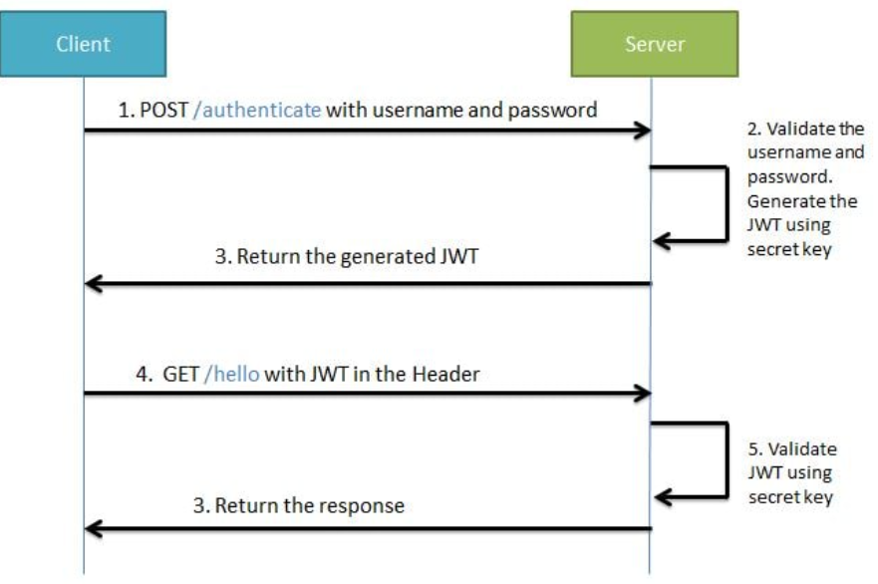
JWT

Slide 8
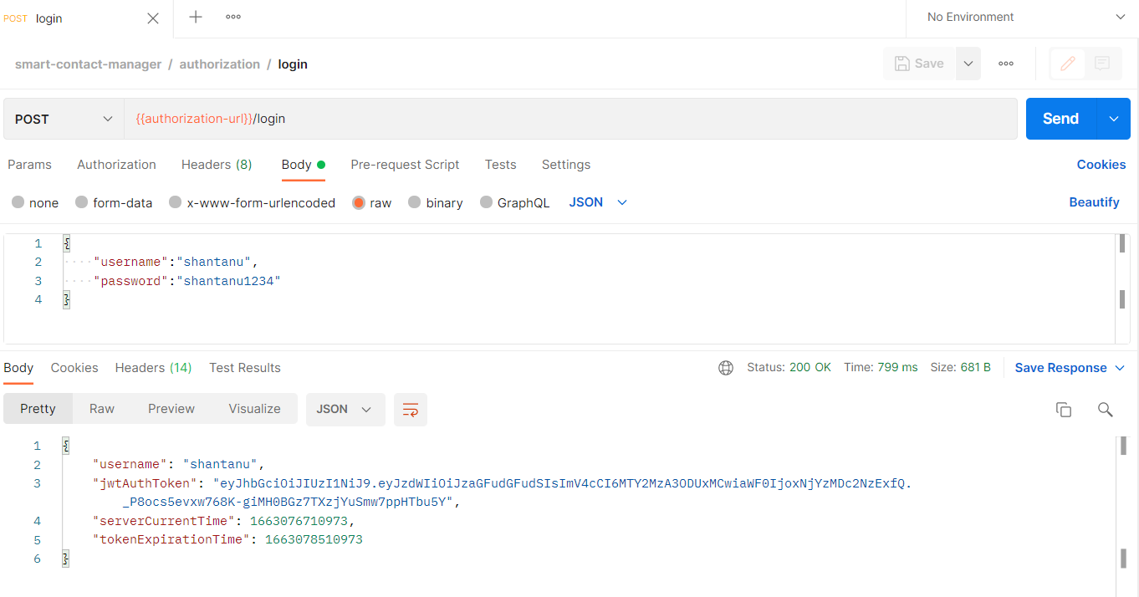
Authorization Microservice - Sample request

Slide 9
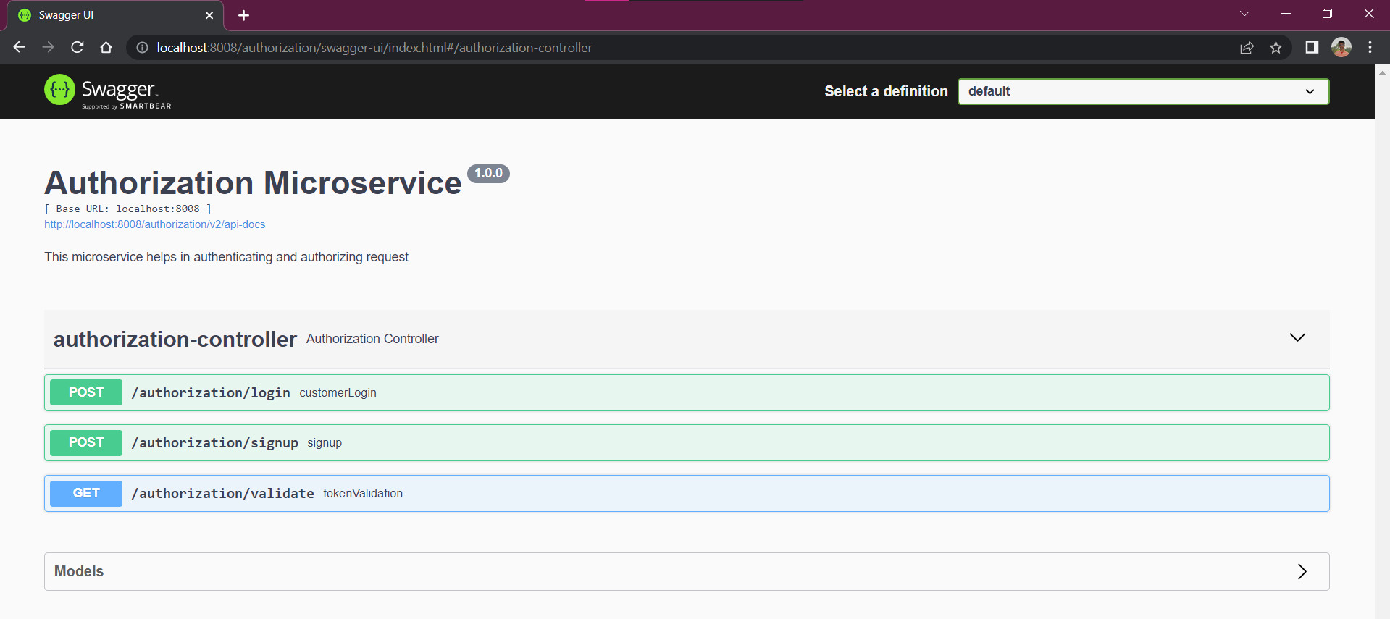
Authorization Microservice – Swagger Documentation

Slide 10
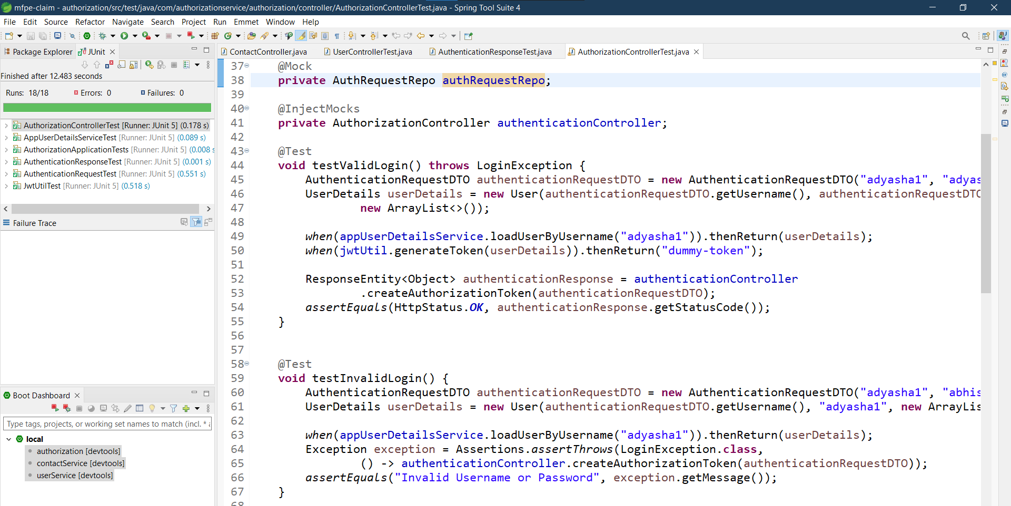
Authorization Microservice – Unit Testing

Slide 11
Contact Microservice
Contact microservice will performs operations like :
Add Contact
Update Contact
Delete Contact
Fetch Contacts
It interacts with authorization for the purpose of token validation.

Slide 12
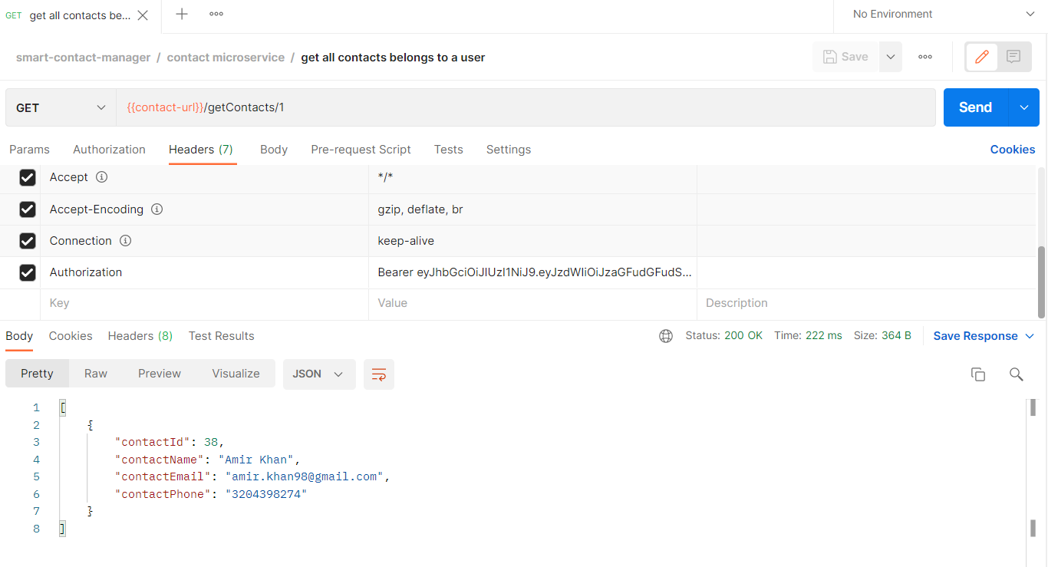
Contact Microservice - Sample request

Slide 13
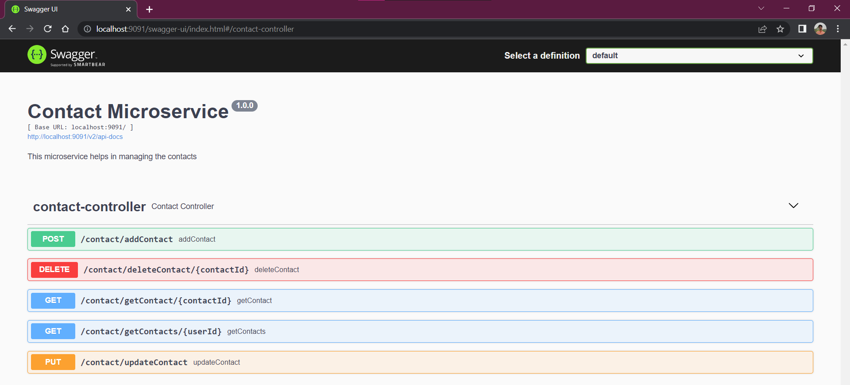
Contact Microservice – Swagger Documentation

Slide 14
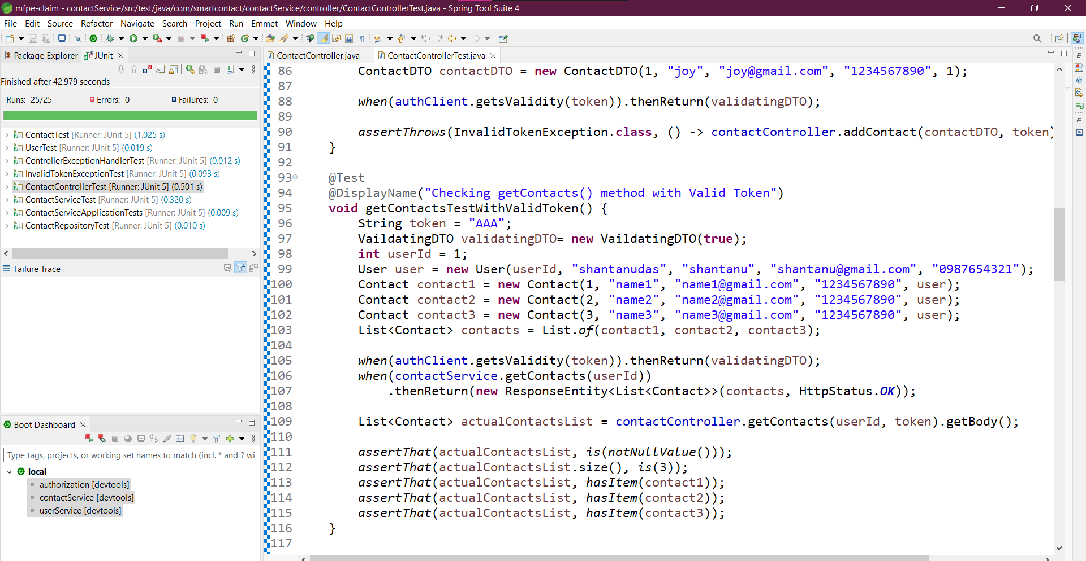
Contact Microservice – Unit Testing

Slide 15
User Microservice
User Microservice will perform following operations:
Add user
Fetch user
Interacts with Authorization microservice for token validation

Slide 16
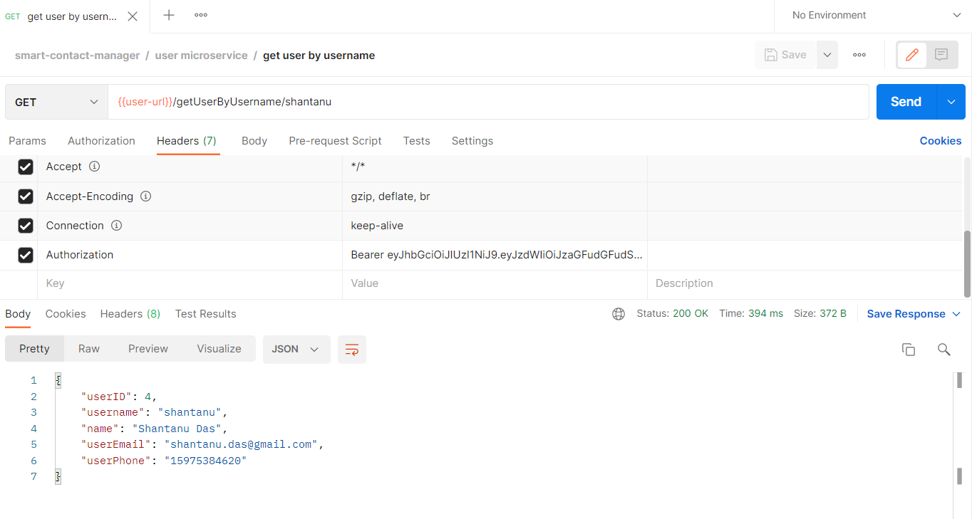
User Microservice - Sample request

Slide 17
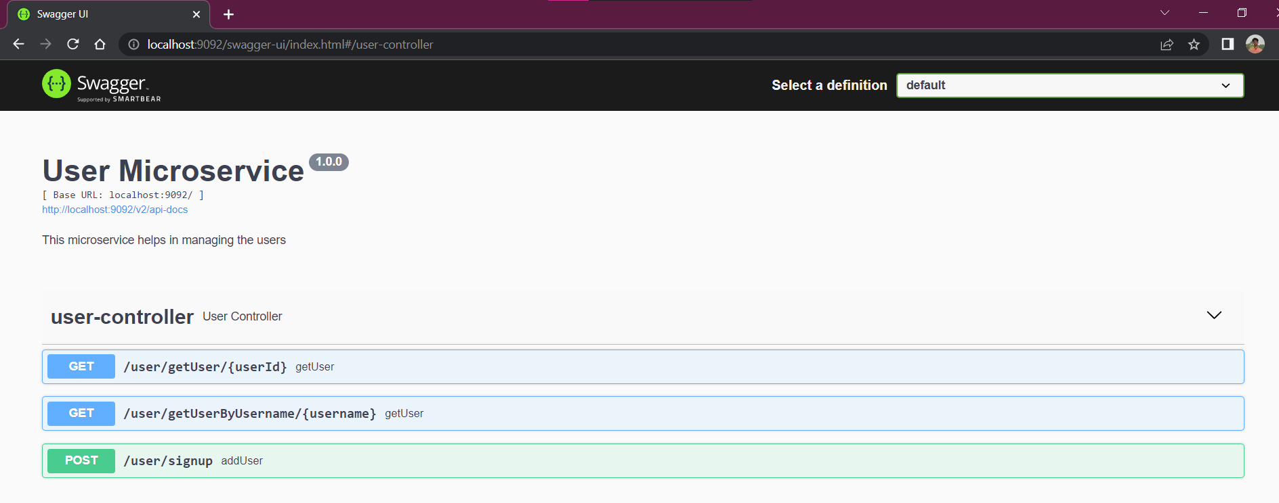
User Microservice – Swagger Documentation

Slide 18
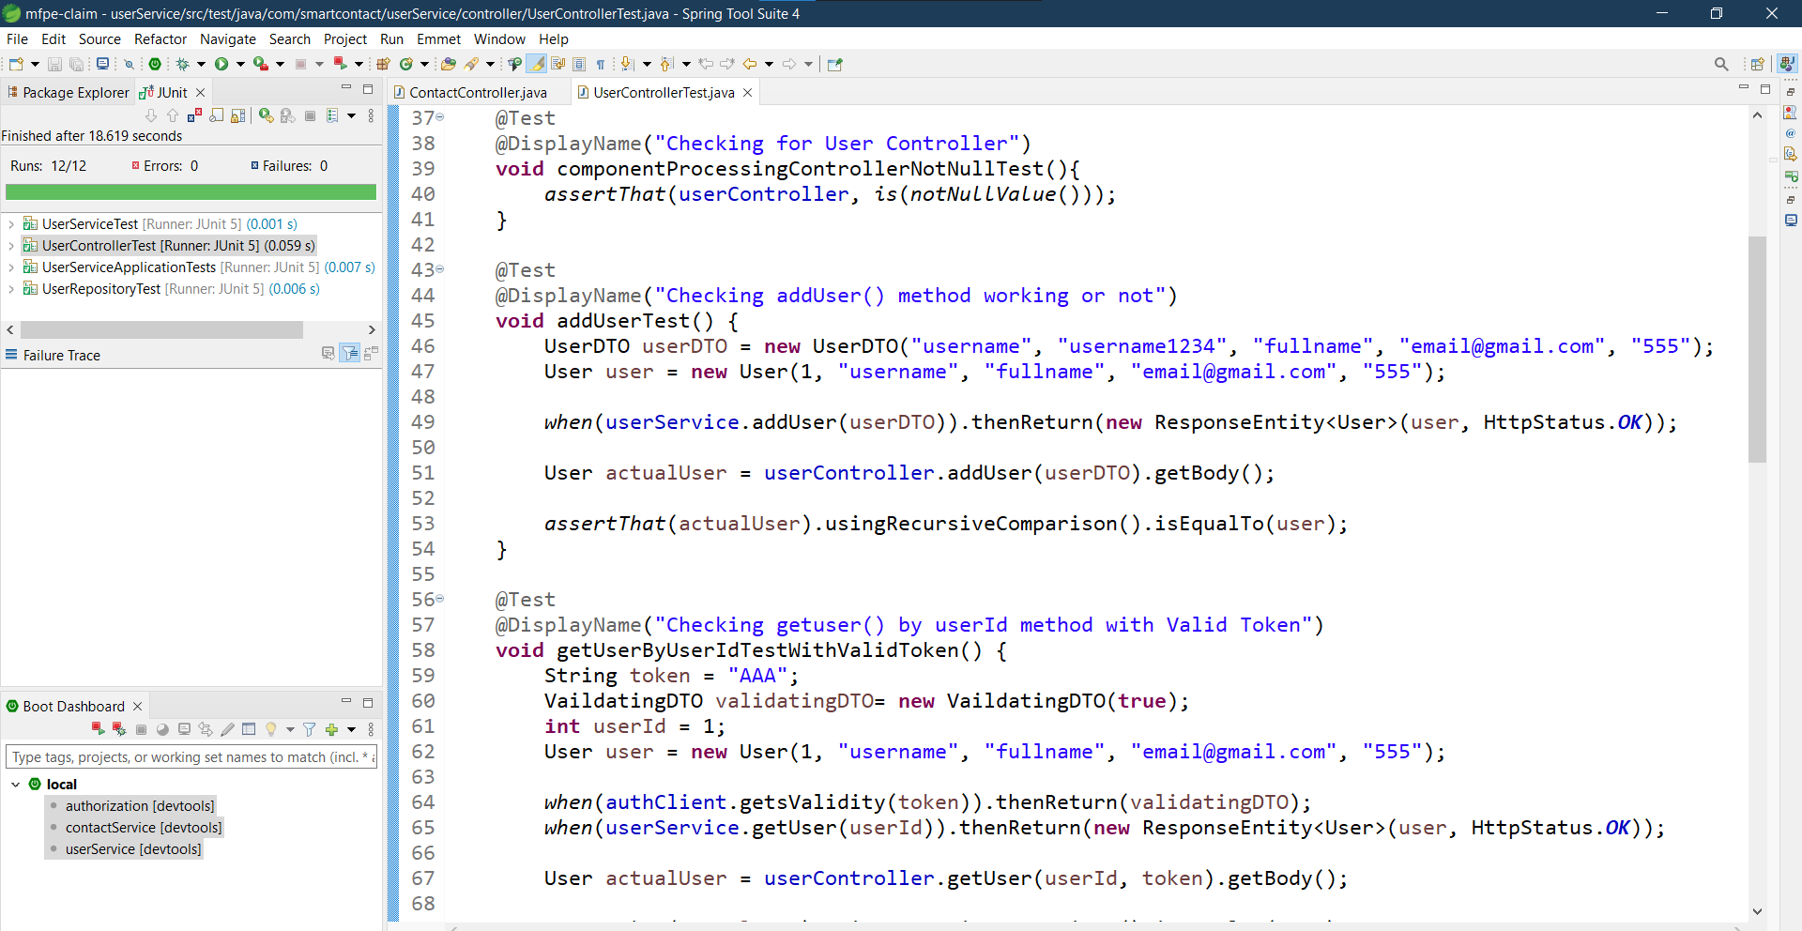
User Microservice – Unit Testing

Slide 19

Video

Slide 20
Thank You ...!

